Slide 1
AHSMC 2011
Part II

Slide 2
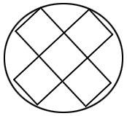
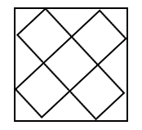
Problem 1.
A cross shaped figure is made up of five unit squares. Determine which has the larger area: the square containing the cross or the circle containing the cross.

Slide 3
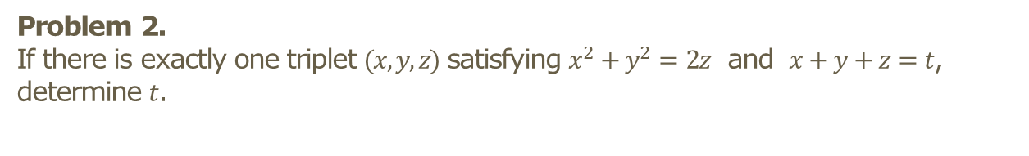
Problem 2.
If there is exactly one triplet $(x,y,z)$ satisfying $x^{2}+y^{2}=2z$ and $x+y+z=t$, determine $t$.

Slide 4
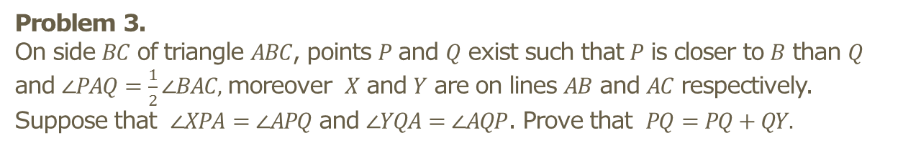
Problem 3.
On side $BC$ of triangle $ABC$, points $P$ and $Q$ exist such that $P$ is closer to $B$ than $Q$ and $∠PAQ=\frac{1}{2}∠BAC,$ moreover $X$ and $Y$ are on lines $AB$ and $AC$ respectively. Suppose that $∠XPA=∠APQ$ and $∠YQA=∠AQP$. Prove that $PQ=PQ+QY.$

Slide 5
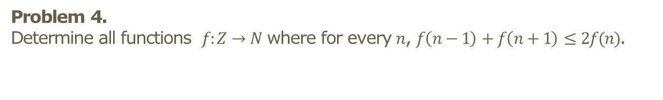
Problem 4.
Determine all functions $f:Z→N$ where for every $n$, $f\left(n−1\right)+f\left(n+1\right)≤2f(n)$.

Slide 6
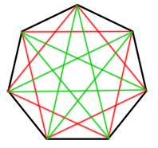
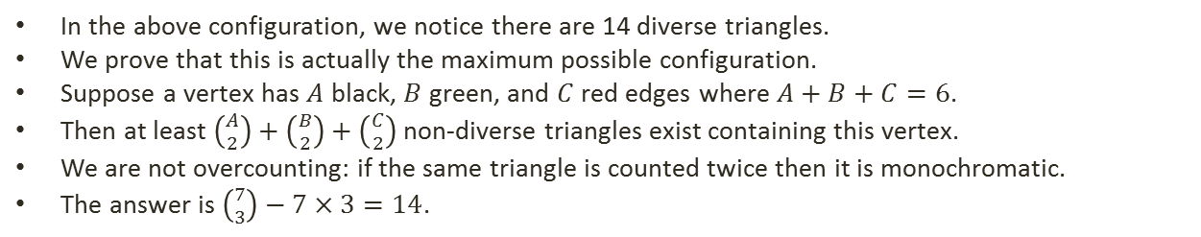
Problem 5.
Seven teams gather to play one of three sports, and no set of three teams play the same sport among themselves. A triplet is considered diverse if all three sports are played among themselves. What is the maximum possible number of diverse triplets?
In the above configuration, we notice there are 14 diverse triangles.
We prove that this is actually the maximum possible configuration.
Suppose a vertex has $A$ black, $B$ green, and $C$ red edges where $A+B+C=6$.
Then at least $\left({A \atop 2}\right)+\left({B \atop 2}\right)+\left({C \atop 2}\right)$ non-diverse triangles exist containing this vertex.
We are not overcounting: if the same triangle is counted twice then it is monochromatic.
The answer is $\left({7 \atop 3}\right)−7×3=14$.

